Slide 1
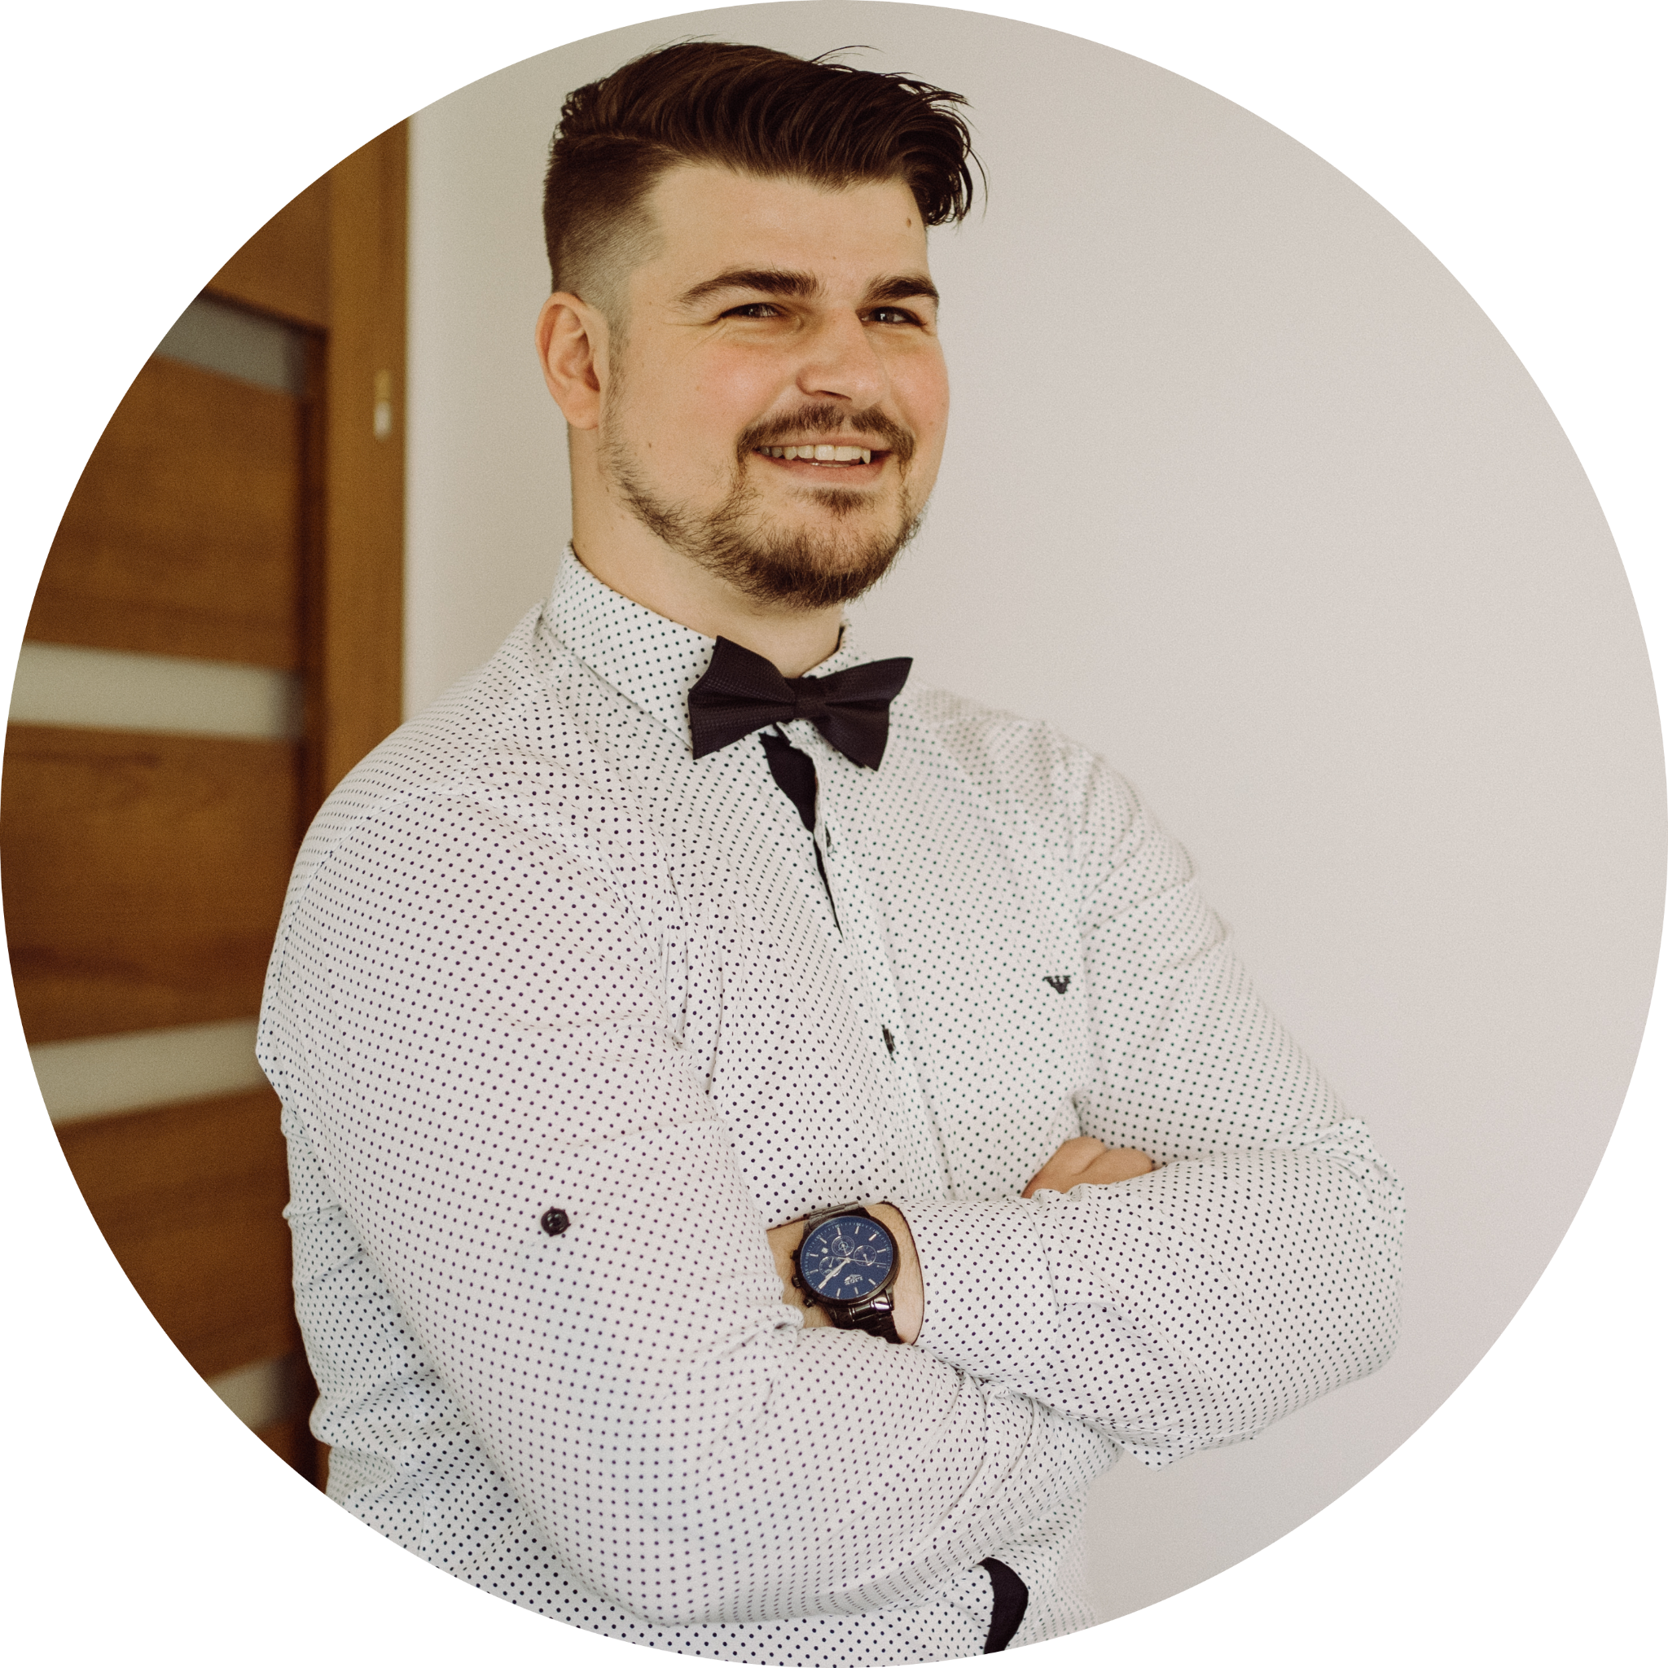
Is gaming marketing
for every brand?
WOJCIECH
GRZEGORZYCA
BARTOSZ SEMEGIN

Slide 2
THE #1 GAMING MARKETING AGENCY
IN THE REGION
WE PROVIDE ENGAGING AND EFFECTIVE COMMUNICATION IN CONNECTING BRANDS WITH GAMERS
EXPERIENCE
SCALE OF ACTION
REACH
EFFECTS
100 clients in 2021, mainly within consumer-based categories (FMCG, services, ecommerce).
1000 implementations with creators in 2021
17 European markets within our largest project for client Epic Games
4 offices in four countries (Poland, Greece, Bulgaria, Romania)
10 mln unique gamers in Poland watch content from our creators (IQS)
100% coverage of gaming-related viewers through our actions
100 mln in global reach achieved in our campaign for Greenpeace
30 awards received for campaigns at Cannes Lions, Effie Awards, Mixx Awards
WE HAVE BEEN TRUSTED BY (FULL CASE STUDIES AVAILABLE UPON REQUEST)

Slide 3
TODAY’S PRESENTATION AGENDA:
Redefinition of known terms
The gaming phenomenon
The gaming’s role in marketing
A few practical tips for you
Our campaigns' case studies
Answer for the title question
Time for your questions

Slide 4
GAMING AND GAMERS
GAMING
IS EVERYTHING RELATED TO PLAYING, CREATING AND WATCHING VIDEO GAMES.
GAMERS
ARE PEOPLE ENGAGED "ACTIVELY" (PLAYING) AND "PASSIVELY" (CONSUMING CONTENT) IN GAMING.

Slide 5
WHAT GAMING MARKETING IS?
GAMING MARKETING
IS ALL MARKETING COMMUNICATION THAT USES GAMING PHENOMENON TO GENERATE BRAND AWARENESS, CREATE IMAGE OR DRIVE SALES.
THE TARGET GROUP IS MOST OFTEN GAMERS.

Slide 6
ENDEMIC VS. NON-ENDEMIC
ENDEMIC BRANDS
REPRESENT PRODUCTS OR SERVICES THAT
ARE USED FOR PLAYING VIDEO GAMES
NON-ENDEMIC BRANDS
REPRESENT PRODUCTS OR SERVICES THAT
ARE NOT USED FOR PLAYING VIDEO GAMES

Slide 7
WHY GAMING?
ELUSIVENESS
ENGAGEMENT
EAGERNESS
2X
8,5H
56%
more gamers aged 18-45
prefer video games
over TV or movies
average playtime for gamers a week, a +14% rise YoY in 2021
of gamers say they
trust brands,
+9 pts vs. non-players
= hard to reach
via traditional media
= spending a lot of time on the activity
= more open to
marketing
Source: Limelight
Source: Limelight
Source: GAMELOFT

Slide 8
GAMING = SCALE
THERE ARE…
3 BILLION GAMERS IN THE WORLD (PEOPLE PLAYING EVERY MONTH)
41% of total population 65% of all Internet users
which is:

Slide 9
GAMING = SCALE
PEOPLE PLAYING VIDEO GAMES / GAMES LIVE STREAMING AUDIENCE / ESPORTS AUDIENCE
3,1 BLN
921 MLN
532 MLN
Source: Newzoo, estimates for 2022
Of course, it does not mean there are 4,5 billion people interested in this form of entertainment

Slide 10
WHAT DO BRANDS NEED?
GAMING ANSWERS THE MOST IMPORTANT NEEDS OF BRANDS.
IT IS ALSO A HUGE MULTIVERSE OF CONTEXTS, THANKS TO WHICH PRACTICALLY EVERY BRAND CAN FIND ITSELF IN IT.
1
BE A PART OF THE YOUTH CULTURE IN A CREDIBLE WAY
GAMING
3
2
CATCH ATTENTION OF CONSUMERS, REFRESH BRAND ASSOCIATIONS
USE NEW MEDIA & PLATFORMS EFFECTIVELY

Slide 11
GAMING’S ROLE IN THE SALES FUNNEL
audience
BUSINESS GOALS
TOOLS USED
1. Increase brand awareness
2. Additional reach to the audience
3. Brand image enhancement
I. Cooperation with professional players, organizations and leagues, sponsorships, events, own formats
II. The use of contexts relating to gaming competition in media campaigns and content
AWARENESS
RETARGETING
Social media data (e.g. Twitch, YouTube)
III. Involvement through contests or tournaments
IV. Use of gamification mechanisms, interactivity (e.g. on Twitch or dedicated platforms)
ENGAGEMENT
ACQUISITION
4. Generating sales volume
5. Increase product penetration
V. Discount coupons, dedicated kits or products for gamers
VI. Dedicated consumer activations for gamers, loyalty programs
LOYALTY LOOP
repeat acqusition

Slide 12
BEWARE OF THE SHORTCUTS
ESPORTS SPONSORSHIP
IN-GAME ADVERTISING
COOPERATION WITH GAME DEVELOPER
PASSIVE BRAND EXPOSURE
LOW ENGAGEMENT
LIMITED TO A SPECIFIC SEGMENT
LIMITED TO SELECTED TITLES
INTRUSIVE FORM
DIFFICULT TO IMPLEMENT
MOSTLY GLOBAL DEALS
REQUIRES TIME & MONEY
LONG-TERM COMMITTMENT

Slide 13
HOW TO APPROACH?
1. Set the business goals for gaming activities
BRAND WORLD
2. Analyse target group, positioning, product benefits
3. Create brand role in gaming (key message)
4. Plan 360 campaign with focus on effectiveness
GAMING WORLD
5. Deliver campaign, measure & optimize

Slide 14
HOW TO APPROACH?
GAMING
YOU SHOULD BE HERE
TARGET GROUP
PRODUCT

Slide 15
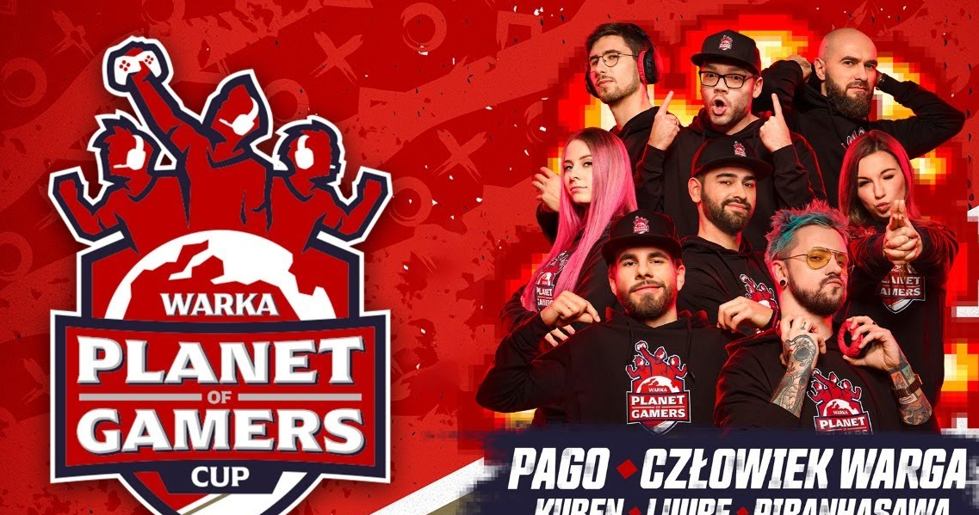
CASE STUDY: WARKA
WARKA - PROJECT WARKA PLANET OF GAMERS
CHALLENGE: Creating a new communication concept aimed at players, matching the concept of Planet Warka and reaching out to young audience.
PREPARATION:
The project included the creation of a proprietary Warka Planet of Gamers platform aimed at gaming and esports fans. It referred to the heritage of the brand (Planeta Warka) and its power to unite Poles around sports emotions.
EXECUTION: The Planet of Gamers platform was introduced through the Planet of Gamers Cup, a proprietary tournament. The tournament was first announced during Intel Extreme Masters in Katowice, Poland. From then on, eight selected creators promoted the tournament until it came to finals. For three days they competed against each other in four games, and their rivarly were broadcast on YouTube and Twitch. It was the first gaming marketing campaign of an alcoholic beer brand in Europe.
EFFECTS
Live stream of the finals hit 500,000 views
50% of the target group heard of the tournament
Warka is the most recognizable beer brand in Polish gaming

Slide 16
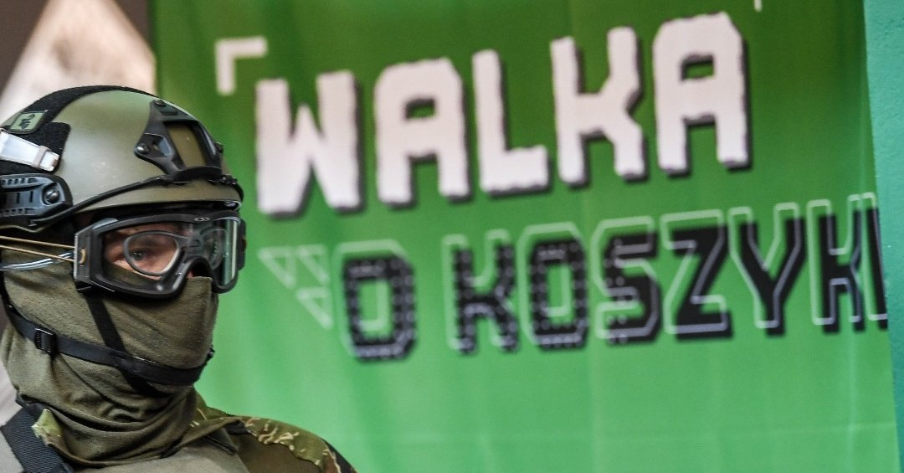
CASE STUDY: ERBUD
ERBUD - RECRUITMENT CAMPAIGN IN GAMING
CHALLENGE: Erbud is one of the five largest construction groups on the Polish market. Staff shortages are one of the main constraints on the development of this sector. Our goal was to reach out to students and graduates of technical faculties with an original idea and thus encourage them to apply for an internship in ERBUD.
PREPARATION:
We didn’t want to limit ourselves to basic forms of promotion. We decided to propose an activity which will connect offline and online worlds.
EXECUTION: We encouraged students to help create a dedicated ERBUD map in CS:GO, modeled on Warsaw's Hala Koszyki (ERBUD’s iconic project). For the grand final of the project we organized a live tournament set in the facility. It was the first metaverse employer branding campaign in Poland and probably Europe
EFFECTS
Our project reached 650,000 students
700 applications for an internship (over 11 applicants per position)
4-fold increase in internship applications relative to 2020

Slide 17
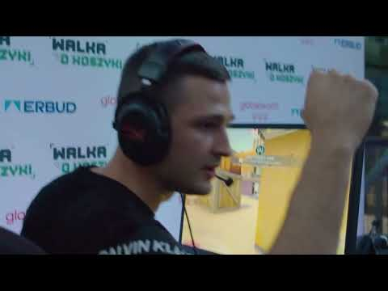
CASE STUDY: ERBUD

Slide 18
SO IS GAMING MARKETING
FOR EVERY BRAND?

Slide 19
YES, but...

Slide 20
...YOU SHOULD REMEMBER I.A. TO:
1
Define the business goal
2
Have an original idea
3
Set the brand in the context
4
Define the audience group

Slide 21
THANK YOU
FOR YOUR ATTENTION
WOJCIECH GRZEGORZYCA wojciech.grzegorzyca@gameset.co
BARTOSZ SEMEGIN bartosz.semegin@gameset.co

